Slide 1
Interactive Tutorial on
Linear Programming
Team Member:-
Divya Harita [IU1783830012]
Internal Guide:-
Prof. Krishna Modi

Slide 2
INDEX
Project Profile
  Scope of the system
  Tools & Technology
Analysis
  Need for the System
  Block Diagram
Current Status
Bibliography
Online :
https://script.google.com/a/macros/iict.indusuni.ac.in/s/AKfycbxZB1G-jdnDGJLI2Xh_vbI6jAMsQLHr4eRzhRh4H3W9I-9nVOs/exec

Slide 3
Project Profile
Scope of The System
  This tutorial focuses on developing an Online Interactive tutorial for students who find it difficult to understand Linear Programming concepts.
  This tutorial starts from the very basic concepts starting from what is a linear equation and will pass on to explaining the difficult concepts of Linear Programming.
  It provides different modules, each module will have about 4 to 5 units and each module will focus on different concepts of Linear Programming.
  This tutorial provides interactive tools such as sliders and will allow the students to play and make changes in the values of variables
  The students will observe and analyse the results in the graph and learn the relevant concept for each module.

Slide 4
Project Profile
Tools & Technologies
HTML + CSS + Javascript along with libraries listed below:
Chart.js:
  Open source JavaScript library that allows us to draw different types of charts on HTML-5 canvas element.
Jquery:
  Library of utilities for element search/selection, manipulation, animation etc.
JQuery UI:
  Collection of GUI widgets, animated visual effects and themes implemented with Jquery, CSS and HTML.
Bootstrap:
  CSS Framework for web sites with consistent and modern look and feel, having responsive features
Math.js:
  An extensive mathematics library for Javascript and Node.js.

Slide 5
Analysis
Need for the System:
An interactive tutorial is the best way to understand concepts. Currently, we find no such interactive tutorials on linear programming.
The tutorial will provide hands-on experience to students because the students have the facility to interact with it and observe the effects.
By this, the students will be able to learn effectively and will be able to retain the concepts which is not possible when they read a book or simply read a non- interactive website.
Lastly, this tutorial will focus on making learning an enjoyable experience instead on it becoming a source of stress and boredom.

Slide 6


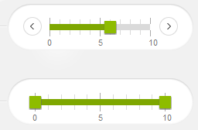


Block Diagram:
Graphical
Visualization
Proteins
Bananas
Vitamins
Apples
Jquery(Utilities)
Chart.js library
API
API
Javascript code
Math.js
Jquery(UI)
events
Apples
Vitamins
GUI
Bananas
Proteins

Slide 7
Current Status
Familiarization with Jquery UI( e.g sliders) .
Familiarization with Chart.js in our Javascript code.
Implemented basic demo of UI slider and interactive chart.
Planned the layout of web pages and built it out using bootstrap for the UI and Text Panels.
Implemented first three tutorial modules.
  Module1: Basic Overview of Linear Programming, explaining what Linear Programming is all about.
  Module 2: Review of Linear Equations .
  Module 3: Inequalities, Constraints, Feasible Region

Slide 8
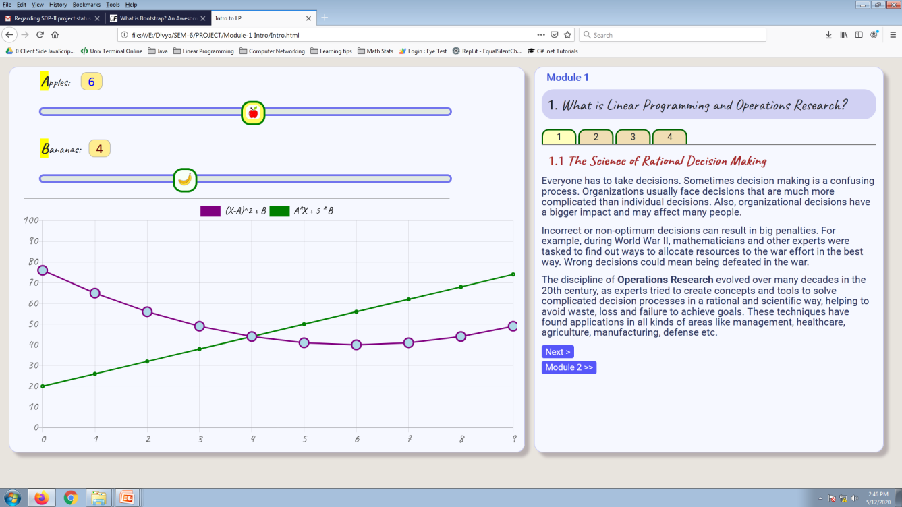
Typical Layout of Tutorial Web Page
GUI Area
Notes and Guidelines
Slider
Chart
Section Tabs
Nav Buttons

Slide 9
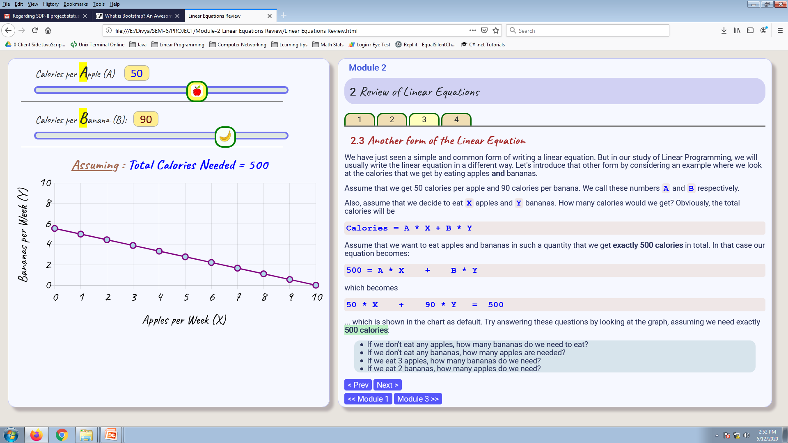
Module 2
[Quick Review of Linear Equations]

Slide 10
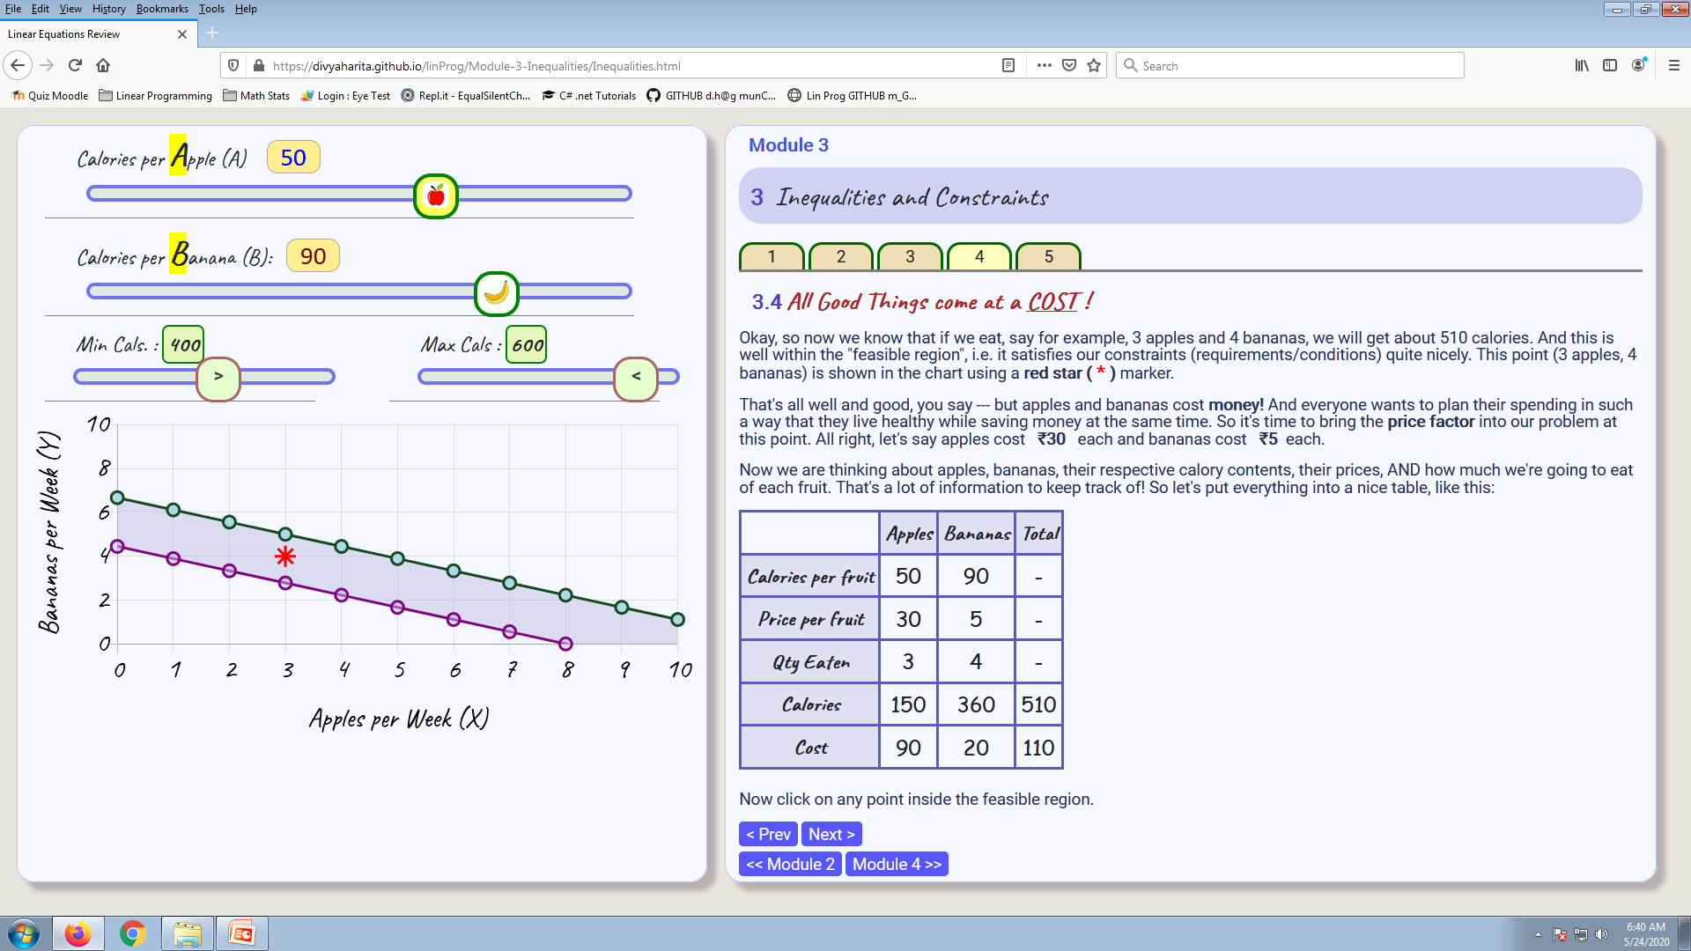
Module 3
[Inequalities, Constraints, Feasible Region]

Slide 11
Bibliography
Chart.js : www.chartjs.org
JQuery : www.jquery.com
Jquery UI : www.jqueryui.com
Bootstrap : getbootstrap.com
Math.js : mathjs.org
W3Schools.org
Sharma, JK: Operations Research, Theory & Applications
Video Tutorial on L.P. by Prof. Wen Shen, Penn State University
  https://www.youtube.com/watch?v=FdKgeeb4q3w

